Slide 1
CS186 Week 7: Aggregation and Query Optimization
10/22/2013

Slide 2
Agenda
Hashing / Sorting Refresher
Aggregation
(Brief!) Query optimization intro
Evaluate me!

Slide 3
Hashing/Sorting
Sorting:
Pass 1 sorts into N/B runs of size B
Pass 2+ merges B-1 runs at a time
Optimization: Tournament Sort. Pass 1 sorts into N/2B runs of size 2B
In 2 passes, sort B(B-1) pages of data
1 + ceil(log_{B-1}ceil(N/B)) passes required (N/2B w/ optimization)
Hashing:
Pass 1 uses coarse-grained hash function to produce B-1 partitions
Pass 2 loads each partition into memory, rehashes them, and writes them out to disk (or probes them for hash join).
Any partition of size > B must be repartitioned (repeat step 1)
In 2 passes, sort B(B-1) pages of data
1 + ceil(log_{B-1}ceil(N/B)) passes required for N pages of data
Do the review exercises!

Slide 4
Aggregation
SELECT COUNT(*) FROM Students;
How could we answer this query?
Scan…
Use an (alt 2/3) index?
System catalogs!

Slide 5
Aggregation
SELECT seniority, COUNT(*) FROM Students GROUP BY seniority;
How could we answer this query?
Sort, then scan
Scan and keep 4 numbers in memory
Use an index on (seniority)
Use catalogs?
seniority | COUNT(*)
Freshman | 47
Sophomore | 62
Junior | 85
Senior | 70

Slide 6
Sort-Agg for GROUP BY
Steps:
Sort
… aggregate “transVals”
Keep a count-so-far
Or an average-so-far
Or a min-so-far…
Whenever we find a tuple from a new group, output the last group’s transVal.

Slide 7
Sort-Agg Refinement
Can we perform the same refinement we did for sort-merge join? (i.e., aggregate during the merge step?)
Yes.

Slide 8
Hash-Agg for GROUP BY
Steps:
Hash.
Aggregate “transVals” for each in-memory group
And move to the next partition
During Re-Hash:
All sophomores
All juniors

Slide 9
Hash-Agg, y u so bad?
Wait, what about our super-cool algorithm?
“Scan and keep 4 numbers in memory”
A refinement of Hash-Agg to the rescue: Hybrid Hashing!

Slide 10
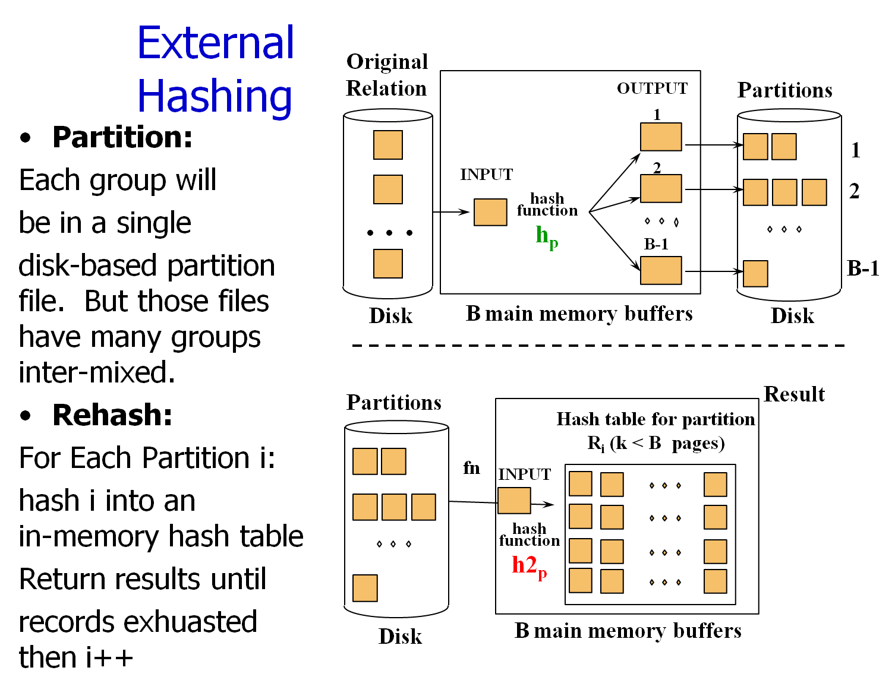

Slide 11
Hybrid Hashing
Let’s take a look at the “Partition” phase.
Add a hash table.
Instead of writing data to disk, put it in the hash table if there’s room.
Keep running totals for each GroupVal.

Slide 12
Hybrid Hashing - example
Original
Relation
So: 12 Fr: 13 Jr: 8 Sn: 20
OUTPUT
Partitions
1
So
1
INPUT
2
Fr
hash
function
h_{p}
2
. . .
So
B-1
B-1
Disk
B main memory buffers
Disk
So: 12 Fr: 13 Jr: 8 Sn: 20

Slide 13
Hybrid Hashing - example
Original
Relation
So: 13 Fr: 13 Jr: 8 Sn: 20
OUTPUT
Partitions
1
So
1
INPUT
2
Fr
hash
function
h_{p}
2
. . .
B-1
B-1
Disk
B main memory buffers
Disk
So: 13 Fr: 13 Jr: 8 Sn: 20

Slide 14
Hybrid Hashing - example
Original
Relation
So: 14 Fr: 13 Jr: 8 Sn: 20
OUTPUT
Partitions
1
1
INPUT
2
Fr
hash
function
h_{p}
2
. . .
B-1
B-1
Disk
B main memory buffers
Disk
So: 14 Fr: 13 Jr: 8 Sn: 20

Slide 15
Hybrid Hashing - example
Original
Relation
So: 14 Fr: 14 Jr: 8 Sn: 20
OUTPUT
Partitions
1
1
INPUT
2
hash
function
h_{p}
2
. . .
B-1
B-1
Disk
B main memory buffers
Disk
So: 14 Fr: 14 Jr: 8 Sn: 20

Slide 16
Hybrid Hashing – example 2
Original
Relation
Fr: 13 Sn: 20
OUTPUT
Partitions
1
So
1
INPUT
2
Fr
hash
function
h_{p}
2
. . .
So
B-1
B-1
Disk
B main memory buffers
Disk
Continues Sophomores and Freshmen like normal hashing!

Slide 17
Duplicate Elimination
SELECT DISTINCT sname FROM Students;
Sorting?
Sure, sort and then scan/remove
Hashing?
Alright, hash and then throw out if already in ReHash

Slide 18
Questions?

Slide 19
Query Optimization
We’ve seen how to perform all the operators.
Select (scan / indexes)
Joins (NLJ / sort-merge / hash-join)
Aggregation
Now how do we find the best way to run a query?
It’s a big search problem!
Really we’re avoiding the worst ways to run a query, not necessarily finding the best one.

Slide 20
Result size estimation
There are 100,000 area codes and 300 million people.
“How many people are in area code 94704?”
300,000,000 / 100,000
We say the selectivity or Reduction Factor of selecting a particular area code is 1/100,000.

Slide 21
Schema for Examples
Sailors (sid: integer, sname: string, rating: integer, age: real)
Reserves (sid: integer, bid: integer, day: dates, rname: string)
As seen in previous lectures…
Reserves:
Each tuple is 40 bytes long, 100 tuples per page, 1000 pages.
Let’s say there are 100 boats.
Sailors:
Each tuple is 50 bytes long, 80 tuples per page, 500 pages.
Let’s say there are 10 different ratings.
Assume we have 5 pages in our buffer pool.
Notes:
3

Slide 22
Motivating Example
SELECT S.sname
FROM Reserves R, Sailors S
WHERE R.sid=S.sid AND
R.bid=100 AND S.rating>5
Cost: 500+500*1000 I/Os
By no means the worst plan!
Misses several opportunities: selections could have been `pushed’ earlier, no use is made of any available indexes, etc.
Goal of optimization: To find more efficient plans that compute the same answer.
Plan:
(On-the-fly)
sname
bid=100
rating > 5
(On-the-fly)
(Page-Oriented
Nested loops)
sid=sid
Sailors
Reserves
Notes:
4

Slide 23
Alternative Plans – Push Selects (No Indexes)
(On-the-fly)
sname
(On-the-fly)
sname
bid=100
(On-the-fly)
bid=100
rating > 5
(On-the-fly)
(Page-Oriented
Nested loops)
sid=sid
(Page-Oriented
Nested loops)
sid=sid
rating > 5
(On-the-fly)
Reserves
Sailors
Reserves
Sailors
500,500 IOs
250,500 IOs
Notes:
5

Slide 24
Alternative Plans – Push Selects (No Indexes)
(On-the-fly)
sname
(On-the-fly)
sname
bid=100
(On-the-fly)
(Page-Oriented
Nested loops)
sid=sid
(Page-Oriented
Nested loops)
sid=sid
rating > 5
bid = 100
(On-the-fly)
(On-the-fly)
rating > 5
(On-the-fly)
Reserves
Sailors
Reserves
Sailors
250,500 IOs
250,500 IOs
Notes:
5

Slide 25
Alternative Plans – Push Selects (No Indexes)
(On-the-fly)
(On-the-fly)
sname
sname
bid=100
(On-the-fly)
rating > 5
(On-the-fly)
(Page-Oriented
Nested loops)
(Page-Oriented
Nested loops)
sid=sid
sid=sid
rating > 5
bid=100
(On-the-fly)
Sailors
(On-the-fly)
Reserves
Sailors
Reserves
6000 IOs
250,500 IOs
Notes:
5

Slide 26
Alternative Plans – Push Selects (No Indexes)
(On-the-fly)
sname
(On-the-fly)
sname
rating > 5
(On-the-fly)
(Page-Oriented
Nested loops)
sid=sid
(Page-Oriented
Nested loops)
sid=sid
(Scan &
Write to
temp T2)
bid=100
rating > 5
bid=100
Sailors
(On-the-fly)
(On-the-fly)
Reserves
Sailors
Reserves
6000 IOs
4250 IOs
1000 + 500+ 250 + (10 * 250)
Notes:
5

Slide 27
Alternative Plans – Push Selects (No Indexes)
(On-the-fly)
(On-the-fly)
sname
sname
(Page-Oriented
Nested loops)
(Page-Oriented
Nested loops)
sid=sid
sid=sid
(Scan &
Write to
temp T2)
(Scan &
Write to
temp T2)
bid=100
rating > 5
rating>5
bid=100
(On-the-fly)
(On-the-fly)
Reserves
Sailors
Sailors
Reserves
4250 IOs
4010 IOs
500 + 1000 +10 +(250 *10)
Notes:
5

Slide 28
Questions?
Lots more on optimization over the next week—there’s more to this than just trying random tricks!
Answer the worksheet exercises!

Slide 29
Evaluate your GSIs!
We’ve made it through the midterm—tell us how to be better!
Fill out the eval sheets, please
This is just a quick checkin: feel free to be informal and anonymous

